Slide 1
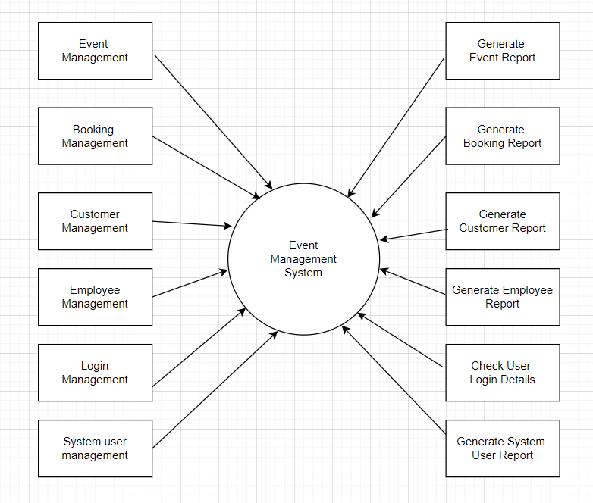
EVENT MANAGEMENT

Slide 2
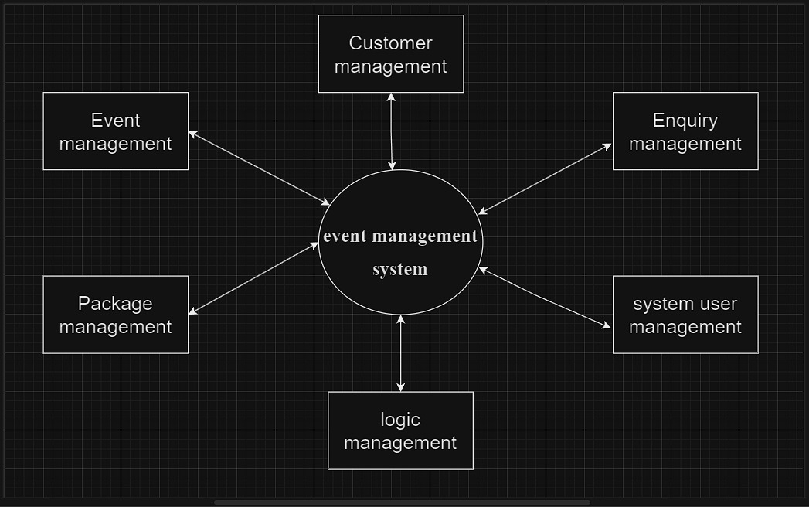

Slide 3
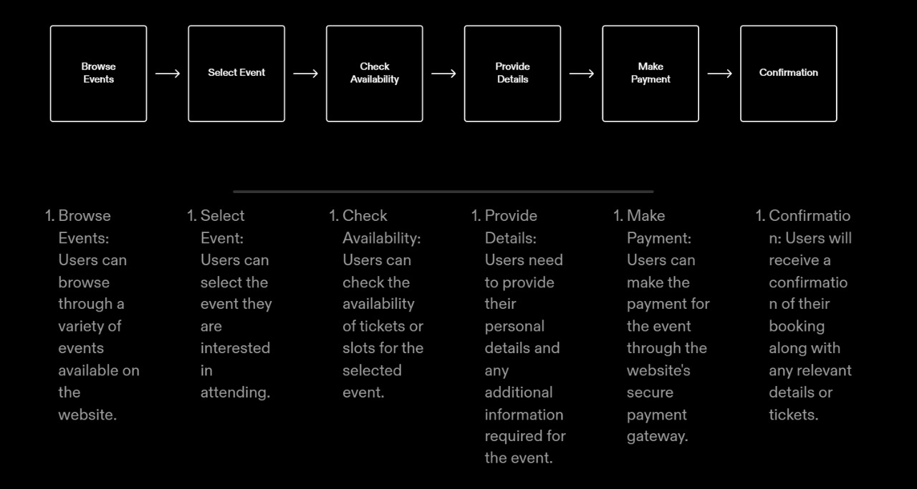
EVENT SELECTION AND BOOKING

Slide 4
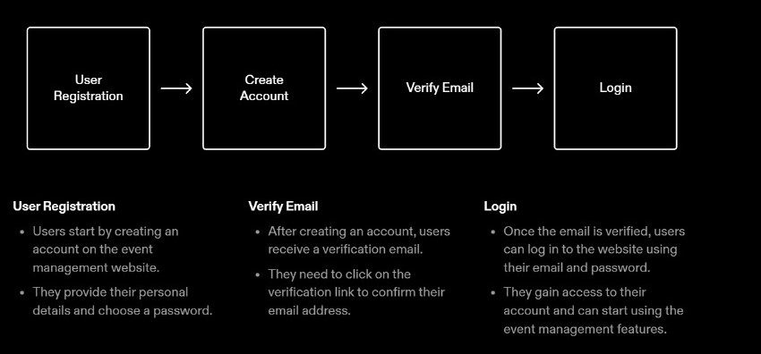
USER REGISTRATION AND LOGIN

Slide 5
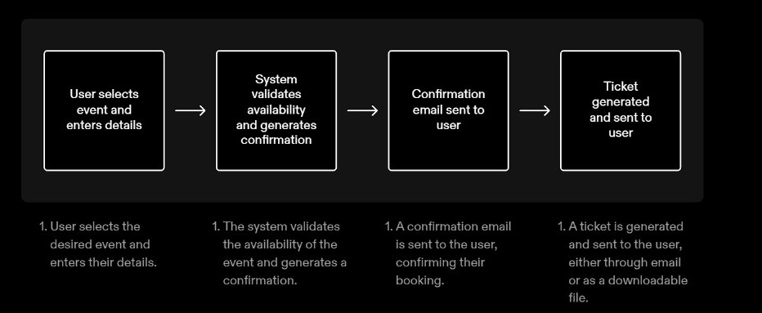
CONFIRMATION AND TICKET GENERATION

Slide 6
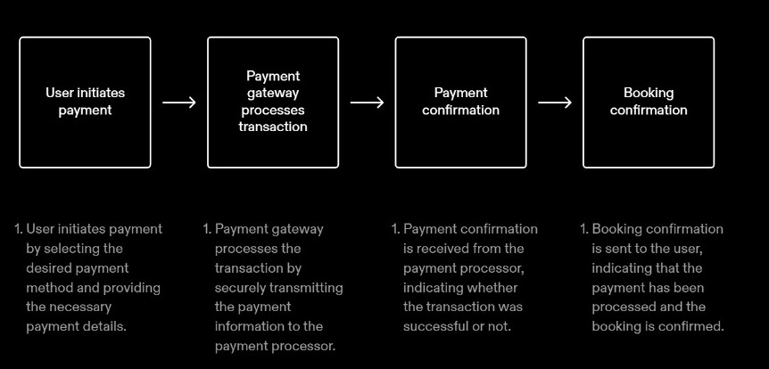
PAYMENT PROCESSING

